Slide 1

NoSQL Databases

Slide 2
Non-relational Database
NoSQL means non-relational databases (not like Excel tables).
These databases are designed for specific data models and allow flexible structures.
Benefits of NoSQL
Flexibility – Easy to change and update data structure.
Scalability – Can handle large amounts of data by spreading across multiple servers.
High Performance – Optimized for fast access to specific types of data.
Highly Functional – Designed for different use cases.

Slide 3
Types of NoSQL Databases
Type | Format | Example | Use Case
Key-Value | Key + Value | DynamoDB, Redis | Session store, cache
Document | JSON | MongoDB | Web apps, CMS
Graph | Node + Relationship | Neo4j | Social network
In-Memory | RAM-based | Redis | Real-time analytics
Search | Indexed text | Elasticsearch | Log / text search
Key-Value (like a dictionary)
Document (stores JSON-like data)
Graph (best for connected data like social networks)
In-Memory (super fast, stores data in RAM)
Search (great for full-text searches)

Slide 4

What is DynamoDB?
DynamoDB is a fully managed NoSQL database provided by AWS.
It is not a relational database like MySQL or PostgreSQL, but a NoSQL database designed for high-performance and massive scalability.
DynamoDB is widely used for applications such as real-time analytics, gaming, IoT, mobile backends, and serverless applications.
Its serverless nature makes it highly appealing for developers aiming for minimal infrastructure management.

Slide 5
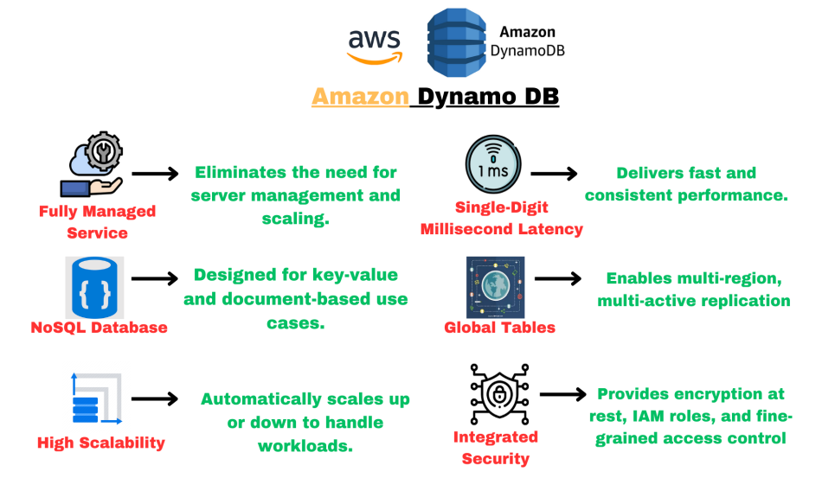

Slide 6

Why Choose DynamoDB?
1. Performance at Scale: DynamoDB can handle millions of requests per second with consistent low latency.
2. Highly Scalable: Automatic scaling adjusts read and write capacity based on traffic patterns, ensuring cost-efficiency.
3. Flexible Data Model: Supports both key-value pairs and JSON documents.
4. Global Accessibility: multi-region replication ensures data availability and fault tolerance globally.
5. Integration with AWS Ecosystem: Works seamlessly with AWS Lambda, API Gateway, and other AWS services.

Slide 7

Key Features of DynamoDB:
Fully Managed : You don’t need to manage infrastructure (no servers, no updates, no patching). • AWS handles provisioning, patching, replication, fault tolerance, backups, etc.
Fast Performance : Single-digit millisecond latency, which means it can respond to requests almost instantly, making it super fast for real-time applications. Consistent performance whether your table has 10 items or 10 million.
Highly Available : DynamoDB automatically replicates your data across 3 Availability Zones (AZs) to ensure it is always available, even if one AZ goes down.
On-Demand and Provisioned Capacity Modes:
On-Demand: Automatically scales based on traffic, suitable for unpredictable workloads.
Provisioned: Pre-configured read/write capacity, suitable for predictable workloads.

Slide 8
Scalable and Serverless : It can handle huge workloads—millions of requests per second, trillions of rows, and hundreds of terabytes (TB) of storage, DynamoDB is serverless, meaning you don’t need to manage servers. It automatically scales to meet your needs.
Integrated Security :Integrated with IAM (Identity and Access Management) for controlling access and security of your data
Low Cost and Auto Scaling : DynamoDB offers low-cost options, and it automatically scales up or down based on the demand, so you only pay for what you use.
Storage Options : Supports Standard and Infrequent Access (IA) table classes.
Use Standard for frequently accessed data and IA for data that is accessed less often, helping save costs.

Slide 9
DynamoDB Streams: Enables real-time processing of data changes, ideal for event-driven architectures.
Global Tables: Provides multi-region replication, ensuring low-latency access and high availability.
Time-to-Live (TTL): Automatically expires and removes outdated data to save costs.
Backup and Restore: Continuous backups with point-in-time recovery ensure data durability

Slide 10

Example:
Let’s say you run an online store that needs to store millions of products and user reviews. Each time a customer views a product, the database needs to fetch the product details and reviews instantly.
DynamoDB can handle this because it can scale up when traffic spikes (e.g., during a sale) and provide fast access to product details in milliseconds.
It automatically replicates the data across different zones, ensuring that even if one server goes down, your data remains available.
Summary : DynamoDB is perfect for applications that need to handle massive data and high traffic.
It’s fast, highly available, and scales automatically with low costs.
Ideal for real-time apps with large amounts of data, like gaming apps, online stores, or social media platforms.

Slide 11

Components of DynamoDB:
Tables :
  A container for your data.
  You define a primary key (partition key or composite key) when creating a table.
Items :
  Equivalent to a row in a relational database.
  Each item is a collection of attributes.
  Each item must have a primary key, but the rest of the attributes can vary from item to item (schema-less).
3. Attributes :
  Equivalent to columns.
  Each attribute is a name–value pair.
  DynamoDB supports several data types:
    ▪ Scalar types: String, Number, Boolean, Binary
    ▪ Document types: List, Map
    ▪ Set types: String Set, Number Set, Binary Set

Slide 12

Primary Key :
  Uniquely identifies each item in the table.
  Two types:
    ▪ Partition Key
    ▪ Composite Key
1. Partition Key (Simple Primary Key):
  Structure: Just one attribute (e.g., UserId, Email, etc.)
  Behavior: DynamoDB uses the Partition Key’s value to compute a hash, which determines which partition (physical storage node) your item goes to.
  Each value of the partition key must be unique in the table.
  Example: Suppose you're storing users:
  Partition Key (UserId) Name Email
  101 Ali Ali@example.com
  102 Afaq Afaq@example.com
  Here, UserId is the Partition Key, and every user has a unique value.

Slide 13
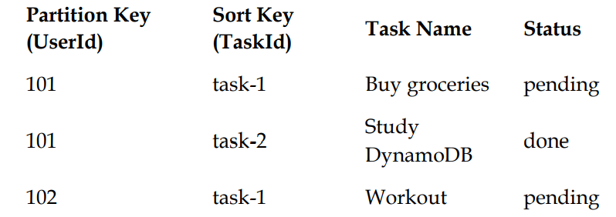
  2. Partition Key + Sort Key (Composite Primary Key):
  Structure: A Partition Key + a Sort Key.
  Behaviour: All items with the same Partition Key are stored together in one partition.
  Items are sorted by the Sort Key within that partition.
  You can store multiple items with the same Partition Key as long as the Sort Key is different.
  Example: Suppose you're storing all tasks by users.
  Here, the primary key is a combination of UserId (Partition Key) and TaskId (Sort Key).
  This allows multiple tasks for the same user, uniquely identified by the combination of both.

Slide 14
Indexes:
Local Secondary Index (LSI):
Uses the same partition key as the base table but a different sort key.
Can only be defined at table creation.
Global Secondary Index (GSI):
Can have different partition and sort keys than the base table.
Can access any attribute, not just primary key.
Can be created any time.

Slide 15
Read and Write Capacity Modes:
DynamoDB offers two capacity modes,
1. Provisioned Capacity:
You manually define Read Capacity Units (RCUs) and Write Capacity Units (WCUs).
Ideal for predictable workloads.
Supports Auto Scaling to adjust capacity as needed.
You pay for:
▪ RCUs: 1 RCU = 1 strongly consistent read/sec for items up to 4KB.
▪ WCUs: 1 WCU = 1 write/sec for items up to 1KB.
Example:
You set 10 RCUs and 5 WCUs:
You can read 40KB of data/sec (10 RCUs × 4KB).
You can write 5KB of data/sec (5 WCUs × 1KB).

Slide 16
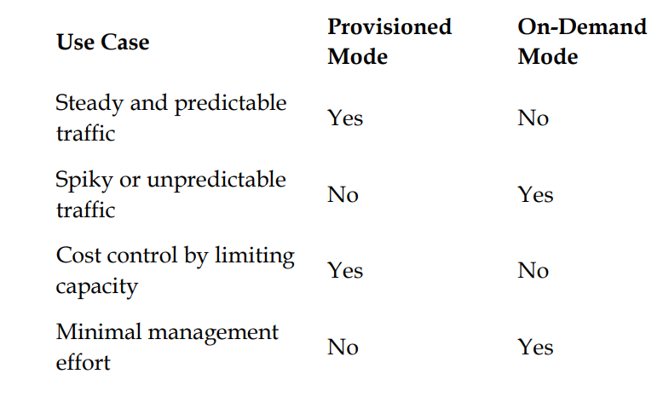
When to Use What?
2. On-Demand Capacity:
  No need to provision capacity.
  DynamoDB auto-scales based on traffic.
  Ideal for unpredictable or spiky workloads.
  You only pay per read/write request.

Slide 17
DynamoDB Accelerator - DAX
DynamoDB Accelerator (DAX) is an in-memory cache for DynamoDB that helps to make your database even faster.
Key Features of DynamoDB
  In-Memory Caching : DAX stores frequently accessed data in memory, so that when your application needs the data again, it can retrieve it much faster than querying DynamoDB directly
  Extremely Fast: It can provide microsecond latency (faster than DynamoDB’s usual millisecond response times), making your application super responsive.
  Fully Managed: just like DynamoDB, DAX is also fully managed by AWS, so you don’t have to worry about setting up, maintaining, or scaling the cache yourself.
  Improves Performance for Read-Heavy Workloads : DAX is especially helpful if your application needs to read the same data repeatedly. It can reduce read latency and offload read requests from DynamoDB.
  Automatic Scaling : DAX scales automatically to meet your workload demands, ensuring that your cache grows as needed to handle more traffic
  Seamless Integration with DynamoDB : DAX is easy to use with DynamoDB, and applications can access it through the same API as DynamoDB, meaning you don’t have to change how you interact with your data

Slide 18

Example
Imagine you run a social media platform.
Users frequently check each other's profiles, which means the profile data is requested a lot. Without DAX, every time someone views a profile, DynamoDB has to retrieve the information from disk, which can take a little time.
With DAX, the profile data is stored in memory, so when another user views the same profile, DAX serves it instantly from memory, speeding up the response time dramatically.
Summary:
DAX is like a boost for DynamoDB, making read-heavy apps even faster by caching data in memory. It’s fully managed and automatically scales, so you don’t have to worry about setup or maintenance. Ideal for applications that need lightning-fast access to frequently requested data.

